Slide 1
Why study this subject?
“The computer lies at the heart of computing. Without it most of the computing disciplines today would be a branch of theoretical mathematics. To be a professional in any field of computing today, one should not regard the computer as just a black box that executes programs by magic. All students of computing should acquire some understanding and appreciation of a computer system’s functional components, their characteristics, their performance, and their interactions. There are practical implication as well. …” JTF01 cited in Stallings 2006, pp. 10

Slide 2
Chapter 1
COMPUTER SYSTEM

Slide 3
Topics
1.1) Computer Main Components
1.2) Computer Functions
1.3) Interconnection Structure
1.4) Bus Interconnection

Slide 4
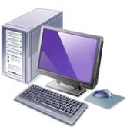
Learning Outcome:
At the end of this chapter, student should be able to:
Describe main computer components
Describe functions of the components
Describe on how the components communicate with each other to perform a task

Slide 5
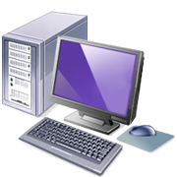
Structure – top level
Peripherals
Computer
Communication
lines
Notes:
SSK3207

Slide 6
Structure – top level
  Controls computer operations and performs data processing functions; often simply referred to as processor
Peripherals
Computer
Central
Processing
Unit
Main
Memory
  Temporarily stores data and instructions that are being executed or will be executed by the CPU
Systems
Interconnection
Computer
  Connects the user and the computer through peripherals and controls the peripherals
Input
Output
Communication
lines
Figure 1: Internal structure of a computer
Notes:
SSK3207

Slide 7
Computer Function
The basic computer function is to execute programs, which includes:
  Data Processing
    Must be able to process data
    The data may take a wide variety of forms and the range of processing requirements is broad
  Data Storage
    It is also essential that a computer store data at least temporarily store those pieces of data that are being worked on at any given moment.
  Data Movement
    Must be able to move data between itself and the outside world
  Control
    Control all the above three functions.

Slide 8
Computer Function
There are 3 main computer components, i.e. CPU, MM and I/O unit that are interdependent when performing their respective tasks.
CPU will perform the processing tasks based on the instructions given by programs and control the operation of the computer.
The instructions are stored in MM and the CPU will fetch and execute them one at a time until all of them are completed.

Slide 9
I/O Unit moves data between the computer and its external environment.
Generally, computers use Stored Program Concept to perform their tasks. This concept was introduced by John Von Newmann (1945)
Stored Program Concept - perform a variety of tasks in sequence or intermittently

Slide 10
Stored Program Concept
1. Data and instructions that will be executed are stored in a single read-write memory.
2. The contents of this memory are addressable by the location, without regard to the type of data contained there.
3. Instructions are executed sequentially based on their position in the memory (unless explicitly modified)

Slide 11
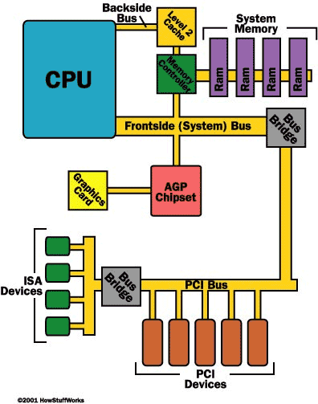

System Interconnection

Slide 12
The components communicate with each other to perform a task.
The collection of paths connecting the various modules is called the System Interconnection Structure
The design of this structure will depend on the exchanges that must be made between modules
A line or pathway that connects the 3 main computer components is called System Bus.

Slide 13
There are 3 types of bus that work together to perform the task:
Data Bus -- Used to transfer data/instructions from one component to another
Address Bus -- Used to transfer the destination address of the data that is inside the Data Bus
Control Bus -- Used to transfer signals that control data and address in Data Bus and Address Bus

Slide 14
A bus consists of multiple communication pathways, or lines and each line is capable of transmitting signals representing binary 1 and binary 0.
    For example, an 8-bit unit of data can be transmitted over 8 data bus lines.
  The size or width of a bus is how many bits it carries in parallel. Common bus sizes are: 4 bits, 8 bits, 12 bits, 16 bits, 24 bits, 32 bits, 64 bits, 80 bits, 96 bits, and 128 bits.
  The speed of a bus is how fast it moves data along the path. This is usually measured in MegaHertz (MHz) or millions of times a second.
  The capacity of a bus is how much data it can carry in a second. In theory this is determined by multiplying the size of the bus by the speed of the bus, but in practice there are many factors that slow down a bus, including wait cycles (waiting for memory or another device to have information ready).
Generally, there are 4 ways to connect the 3 components with the I/O module acting as the control point :
  → I/O to CPU → I/O to MM
  → I/O to Central Switch → I/O to Bus

Slide 15
i. I/O to CPU
MM
ii. I/O to MM
CPU
CPU
MM
I/O U
I/O U
iii. I/O to Central Switch
CPU
Central Switch
MM
I/O U

Slide 16
    iv. I/O to Bus
CPU
MM
I/O U
System Bus

Slide 17

The followings are 3 types of bus interconnection:
  i. Bus Interconnection Scheme
  ii. Traditional Bus Architecture
  iii. High-Performance Architecture
Bus Interconnection Scheme

Slide 18

Multiple-Bus Hierarchies
Performance degrades if great number of devices are connected to the bus:
The more device attached, the greater the bus length
and greater propagation delay
The bus may become bottleneck – aggregate data
transfer demand capacity of the bus

Slide 19
Traditional Bus Architecture
a bus for items closely connected to the processor that can run at or near the same speed as the processor itself.
I/O local devices
connects the main processor with its primary support components, in particular connecting the processor to its memory.
I/O devices
Buffers data transfers between the system bus and the I/O controller

Slide 20
Build to overcome the problem of high performance devices been introduced significantly, that request for faster response and greater speed.
High-performance architecture

Slide 21
High-performance architecture
Cache controller integrated into a bridge (buffering device)
High-capacity I/O devices
lower-speed I/O devices

